Slide 1
Discrete Mathematics Logic and Proofs
by Akkradach W.
Dept. of Computer Engineering
KMITL

Slide 2
Agenda
Chapter 1
Propositional Logic
Propositional Equivalences
Predicates and Quantifiers
Nested Quantifiers
Rules of Inference
Introduction to Proofs
Proof Methods and Strategy

Slide 3
History
Aristotle (384 BC – 322 BC)
Systematic Treatises on Logic
George Boole (1815 – 1864)
The Mathematical Analysis of Logic
The Laws of Thought

Slide 4
Propositional Logic (1)
Proposition declares a fact (either true of false, but not both)
Proposition variables : p, q, r, s, …
Truth value : T or F
Negation of p : ¬p
Conjunction of p and q : p ∧ q
Disjunction of p and q : p ∨ q
Exclusive OR of p and q : p ⊕ q

Slide 5
Propositional Logic (2)
Conditional statement : p → q
Converse q → p
Contrapositive ¬q → ¬p
Inverse ¬p → ¬q
Biconditional statement : p ↔ q
Equivalent : p ≡ q

Slide 6
Propositional Logic (3)
Applications
System Specifications
Boolean Searches
Logic Puzzles
Bit Operations

Slide 7
Propositional Equivalences (1)
Tautology
Contradiction
Contingency
The compound propositions p and q are called “Logically Equivalent” if is p ↔ q a tautology (notation as p ≡ q)

Slide 8
Propositional Equivalences (2)
Logical Equivalences
Identify laws
Domination laws
Idempotent laws
Double negation law
Commutative laws
Associative laws
Distributive laws
De Morgan’s laws
Negation laws

Slide 9
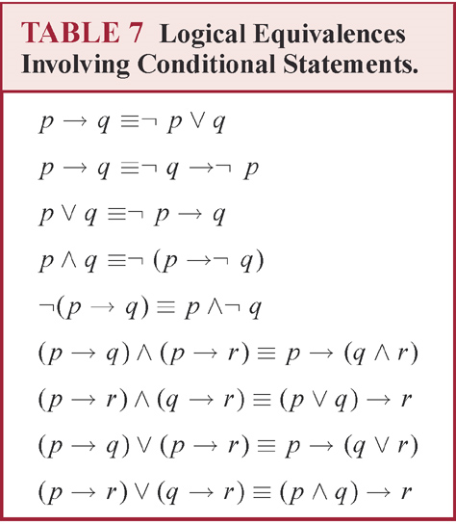
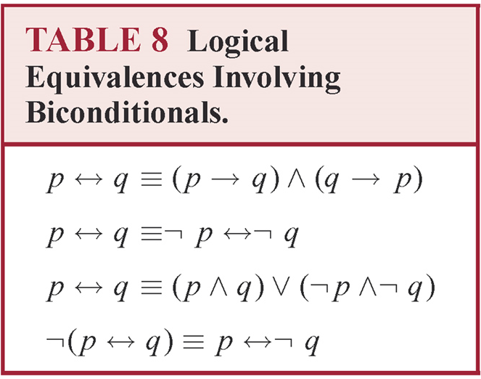
Propositional Equivalences (3)

Slide 10
Predicates and Quantifiers (1)
Predicate Logic
Propositional function P(x) denotes “x > 3”
x > 3 is a predicate
P(4) is true but P(2) is false
Prolog programming language
Universal quantification of P(x) : ∀xP(x)
Existential quantification of P(x) : ∃xP(x)
… with restricted domain : ∀x < 0 (x² > 0)
Which is the same as ∀x(x < 0 → x² > 0)

Slide 11
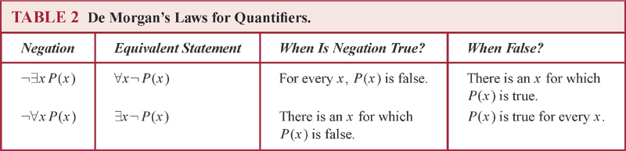
Predicates and Quantifiers (2)
∀x(P(x) ∧ Q(x)) ≡ ∀x P(x) ∧ ∀x Q(x)
¬∃x P(x) ≡ ∀x ¬P(x)
¬∀x P(x) ≡ ∃x ¬P(x)

Slide 12
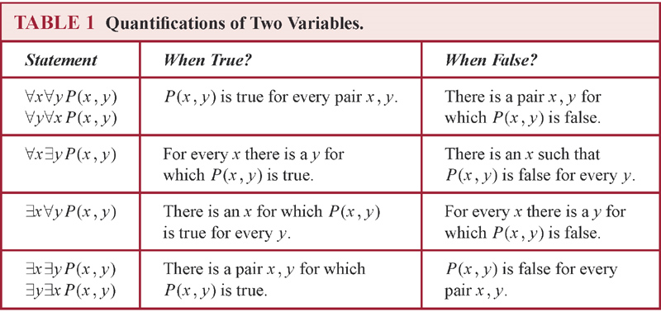
Nested Quantifiers (1)

Slide 13
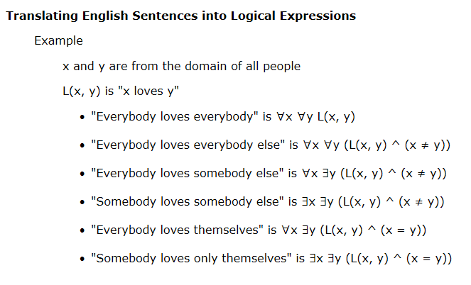
Nested Quantifiers (2)

Slide 14
Nested Quantifiers (3)
Negation of ∀x∃y(xy = 1) is
¬∀x∃y(xy = 1)
∃x¬∃y(xy = 1)
∃x∀y¬(xy = 1)
Because ¬(xy = 1) is (xy ≠ 1)
∃x∀y(xy ≠ 1) is the final answer w/o ¬

Slide 15
Rules of Inference (1)
Argument / Premises / Conclusion / Valid
“If you have a current password, then you can log on to the network.”
“You have a current password.”
Therefore,
“You can log on to the network.”
Argument form
p → q
p
∴ q

Slide 16
Rules of Inference (2)
Premises p₁, p₂, …, p_{n}
Conclusion q
Valid when (p₁ ∧ p₂ ∧ … ∧ p_{n}) → q is a tautology
We can use truth tables to show that argument forms are valid but not efficient ways, instead we use “rules of inference”

Slide 17
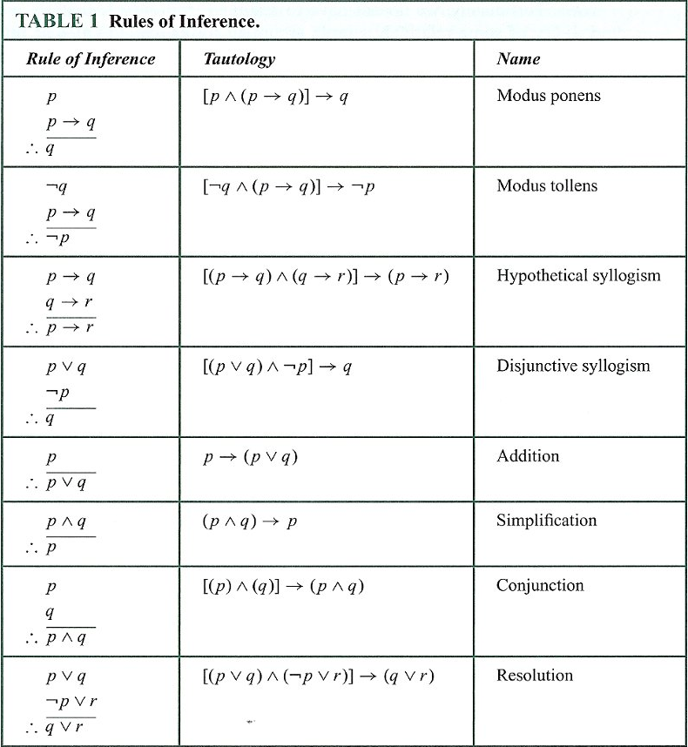
Rules of Inference (3)

Slide 18
Rules of Inference (4)
Show these hypotheses :
“It is not sunny this afternoon and it is colder than yesterday”
“We will go swimming only if it is sunny”
“If we do not go swimming, then we will take a canoe trip”
“If we take a canoe trip, then we will be home by sunset”
Lead to the conclusion :
“We will be home by sunset”

Slide 19
Rules of Inference (5)
Let
p : “It is sunny this afternoon”
q : “It is colder than yesterday”
r : “We will go swimming”
s : “We will take a canoe trip”
t : “We will be home by sunset”

Slide 20
Rules of Inference (6)
Then hypotheses become :
¬p ∧ q “It is not sunny this afternoon and it is colder than yesterday”
r → p “We will go swimming only if it is sunny”
¬r → s “If we do not go swimming, then we will take a canoe trip”
s → t “If we take a canoe trip, then we will be home by sunset”
And the conclusion becomes :
t “We will be home by sunset”

Slide 21
Rules of Inference (7)
Steps
¬p ∧ q
¬p
r → p
¬r
¬r → s
s
s → t
t
Reasons
Hypothesis
Simplification (1)
Hypothesis
Modus (2) and (3)
Hypothesis
Modus (4) and (5)
Hypothesis
Modus (6) and (7)

Slide 22
Rules of Inference (8)
Use “Resolution” to show these hypotheses :
“Jasmine is skiing or it is not snowing”
“It is snowing or Bart is playing hockey”
Imply that :
“Jasmine is skiing or Bart is playing hockey”

Slide 23
Rules of Inference (9)
Let
p : “It is snowing”
q : “Jasmine is skiing”
r : “Bart is playing hockey”

Slide 24
Rules of Inference (10)
Then hypotheses become :
q ∨ ¬p “Jasmine is skiing or it is not snowing”
p ∨ r “It is snowing or Bart is playing hockey”
Resolution : ((♣∨♦)∧(¬♣∨♥))→(♦∨♥)
((q ∨ ¬p) ∧ (p ∨ r)) → (q ∨ r)
((¬p ∨ q) ∧ (p ∨ r)) → (q ∨ r)
q ∨ r “Jasmine is skiing or Bart is playing hockey”

Slide 25
Rules of Inference (11)
Fallacy of affirming the conclusion
“If you do every problem in this book (p), then you will learn discrete mathematics (q)”
“You learned discrete mathematics (q)”
Therefore “You did every problem in this book (p)”
Isn’t it?
… but [(p → q) ∧ q] → p is not tautology!

Slide 26
Rules of Inference (12)
Fallacy of denying the hypothesis
“If you do every problem in this book (p), then you will learn discrete mathematics (q)”
“You did NOT learn discrete mathematics (¬q)”
Therefore “You did NOT do every problem in this book (¬p)”
Isn’t it?
… but [(p → q) ∧ ¬q] → ¬p is not tautology!
WRONG

Slide 27
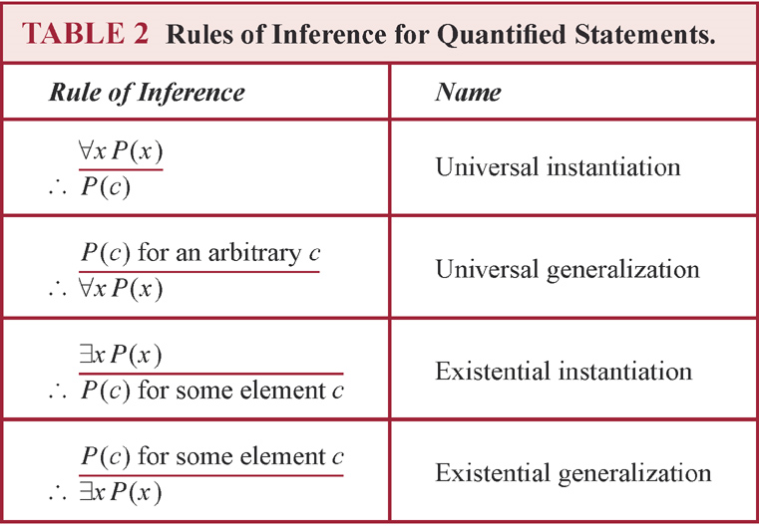
Rules of Inference (13)

Slide 28
Rules of Inference (14)
Show these hypotheses :
“A student in this class has not read the book”
“Everyone in this class passed the first exam”
Imply :
“Someone who passed the first exam has not read the book”

Slide 29
Rules of Inference (15)
Let
C(x) : “x is in this class”
B(x) : “x has read the book”
P(x) : “x passed the first exam”

Slide 30
Rules of Inference (16)
Then hypotheses become :
∃x(C(x) ∧ ¬B(x)) “A student in this class has not read the book”
∀x(C(x) → P(x)) “Everyone in this class passed the first exam”
And the conclusion becomes :
∃x(P(x) ∧ ¬B(x)) “Someone who passed the first exam has not read the book”

Slide 31
Rules of Inference (17)
Steps
∃x(C(x) ∧ ¬B(x))
C(a) ∧ ¬B(a)
C(a)
∀x(C(x) → P(x))
C(a) → P(a)
P(a)
¬B(a)
P(a) ∧ ¬B(a)
∃x(P(x) ∧ ¬B(x))
Reasons
Premise
Exist inst (1)
Simplification (2)
Premise
Universal inst (4)
Modus (3) and (5)
Simplification (2)
Conjunction (6) and (7)
Exist gen (8)

Slide 32
Introduction to Proofs
The theorem is a statement that can be shown to be true (with a proof or proofs)
Proofs can include axioms (or postulates), premises, and other theorems to make valid arguments
Less important theorems may be called propositions (if helpful in the proofs of other results, they are called lemmas)
When a proof of a conjecture is found, it becomes a theorem

Slide 33
Methods of Proving Theorems
Direct proofs
p → q
Proofs by Contraposition
p → q ≡ ¬q → ¬p
Vacuous and Trivial proofs
A little proof strategy
Proofs by Contradiction
¬p → F ≡ ¬p → (¬r ∧ r)
Proofs of Equivalence
Counterexamples

Slide 34
Direct Proof
Proposition: (a+b)² = a²+2ab+b²
(a+b)²
= (a+b)(a+b)
= aa+ab+ba+bb
= a²+ab+ba+b²
= a²+ab+ab+b²
= a²+2(ab)+b²
= a²+2ab+b²
QED.

Slide 35
Proof Methods and Strategy
Mistakes
a = b
a² = ab
a² – b² = ab – b²
(a-b)(a+b) = b(a-b)
a + b = b
2b = b
2 = 1
Let’s fun!
Given
Multiply (1) with a
Subtract (2) with b²
Factor (3)
Divide (4) by a – b
Replace a with b
Divide (6) by b
REALLY?

